Slide 1

INTERACTION BETWEEN HUMAN AND COMPUTER USING HAND GESTURE Mini Project KCS 752/ 7th Sem
Gaurav Singh
1900320150020
gaurav.19b151037@abes.ac.in
Shardul Singh Chauhan
Assistant Professor

Slide 2

Outline
Introduction
Objective
Proposed System
Tools & Technologies Used
Methodology Used
Work - Flow of System
Implementation
Results
Future Enhancements
Conclusion
References

Slide 3

Introduction
The basic goal of Human Computer Interaction is to improve the interaction between users and computers by making the computer more receptive to user needs. Human Computer Interaction with a personal computer today is not just limited to keyboard and mouse interaction. Interaction between humans comes from different sensory modes like gesture, speech, facial and body expressions. Being able to interact with the system naturally is becoming ever more important in many fields of Human Computer Interaction.

Slide 4

Objectives
A real time 2D input device
Translation of gestures to commands
Aid for disabled and deaf people
Hand gesture recognition to design
computer games.

Slide 5
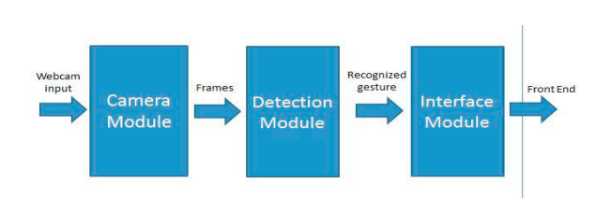
Proposed System

Slide 6

Tools and Technologies Used
Web Cam
Computer System
We use Pycharm to implement
our project.
Our main software is OpenCV Library.

Slide 7
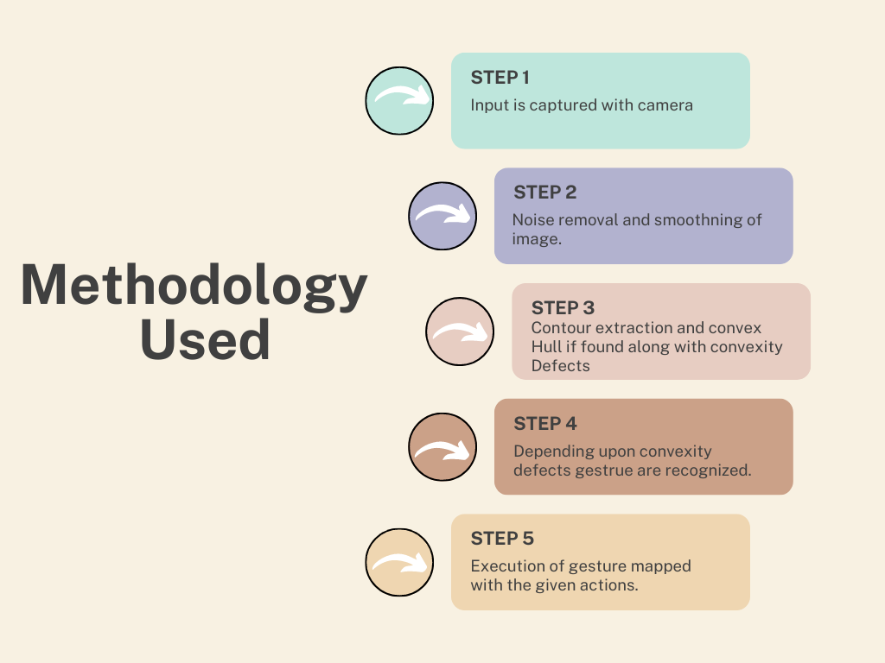

Slide 8
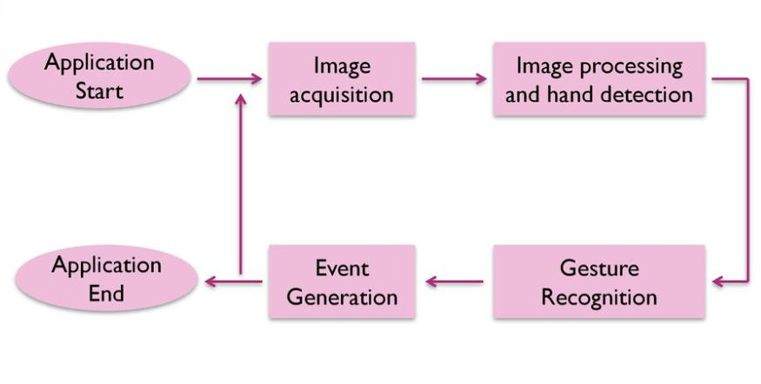
Work Flow of System

Slide 9

Implementation
YouTube link
https://youtu.be/NeRIq9GbyCo

Slide 10
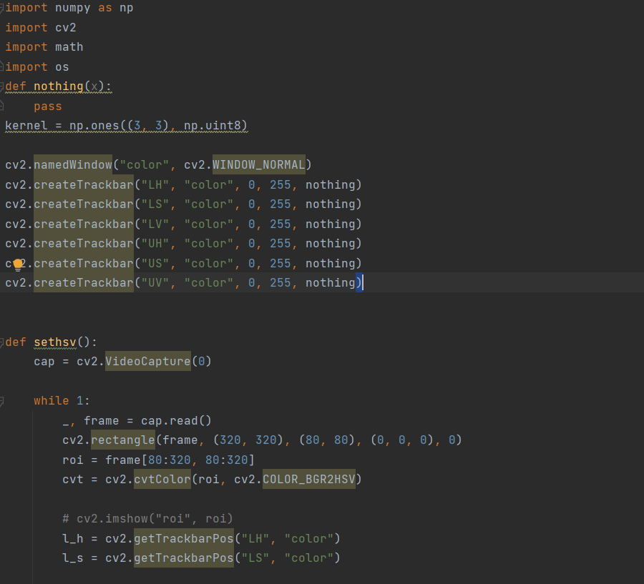
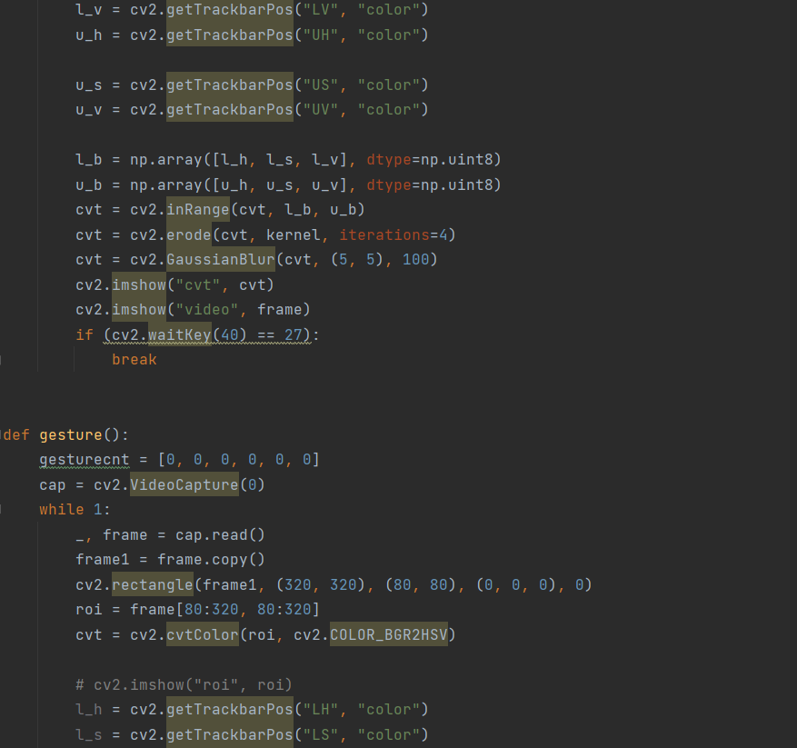
Implementation

Slide 11
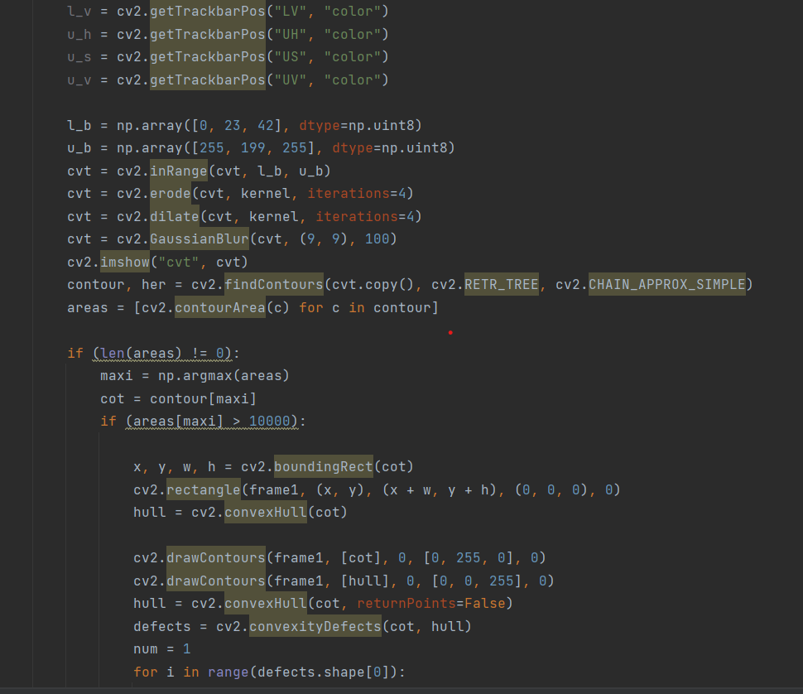
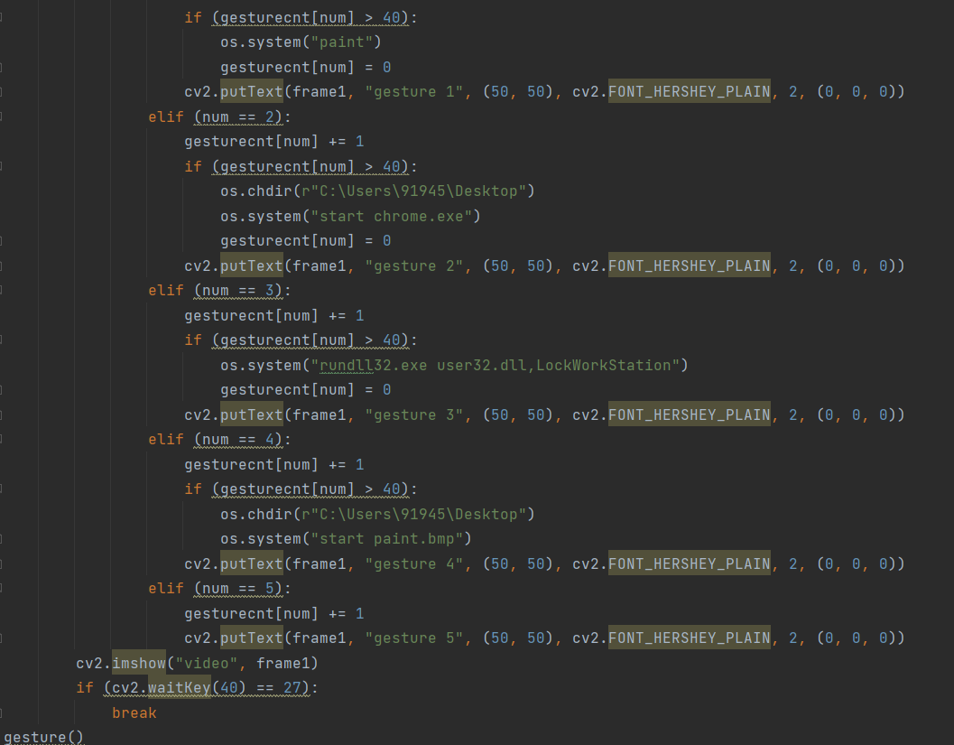
Implementation

Slide 12

Results
Different application of hand gesture recognition have been implemented in different domain.
Finally application is developed which is have good human and computer interaction

Slide 13

Future Enhancements
1- Finally, we target to extend our domain scenarios and apply our tracking mechanism into a variety of hardware including digital TV and mobile devices.
2- We also aim to extend this mechanism to a range of users including disabled users.

Slide 14

Conclusion
We were able to create a robust gesture recognition system that did not utilize any markers, hence making it more user friendly and low cost. In this gesture recognition system, we have aimed to provide gestures, covering almost all aspects of HCI such as system functionalities, launching of applications and opening some popular websites. In future we would like to improve the accuracy further and add more gestures to implement more functions.

Slide 15

References
1-Chanda K, Ahmed W, Mitra S. A new hand gesture recognition scheme for similarity measurement in a vision based barehanded approach. In:Image Information Processing (ICIIP); 2015 Third International Conference on; 2015 Dec 21; ; New York : IEEE;2015.
2-Ishiyama H, Kurabayashi S. Monochrome glove: A robust real-time hand gesture recognition method by using a fabric glove with design of structured markers. In: Virtual Reality (VR); 2016 IEEE ;2016 Mar 19; Greenville, SC; New York : IEEE;2016;p. 187-188.
3-Suriya R, Vijayachamundeeswari V. A survey on hand gesture recognition for simple mouse control. In: Information Communication and Embedded Systems (ICICES); 2014 International Conference on; 2014 Feb 27; India, Chennai; New York : IEEE;2014.
4-Hussain I, Talukdar AK, Sarma KK. Hand gesture recognition system with real-time palm tracking. In: India Conference (INDICON);2014 Annual IEEE ;2014 Dec 11; India, Pune; New York: IEEE; 2014.
5- Ji-Hwan Kim,Nguyen Duc Thang,Tae-Seong Kim. 3-D hand Motion Tracking and Gesture Recognition Using a Data Glove. In; Industrial Electronics; 2009 IEEE International Symposium on ; 2009 July 5; New York : IEEE;2009 ; p.1013-1018.

Slide 16

THANK YOU

